Slide 1
Pipelining Hazards
CS403
Presented by:
Nikhil Singh

Slide 2
Acknowledgement
We take this humble opportunity to express our sincere indebtness to everybody who have extended their help for making this report possible.
It is just beyond our vocabularies and linguistic abilities to express our feelings and gratitude to our teacher for his in exhaustive guidance, sympathy, benevolence which he bestowed upon me during the accomplishment of this work. His encouragement, enthusiasm, valuable discussion, creative criticism and timely interventions went a long way enabling us to complete this report in presentable form.
We are highly grateful to our parents who had been fighting tooth and nail off along my education career to bring our to the present stage. The dedication of this work to them cannot suffice to what extent they have suffered but only may be a slight consideration to them.

Slide 3

Contents
Pipelining
Hazards in Pipelining
Structural Hazards
Data Hazard
Control Hazard
Conclusion

Slide 4
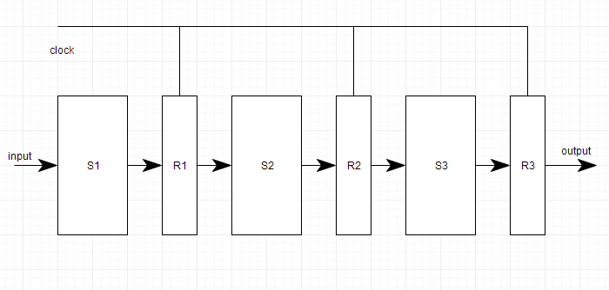
Pipelining
Also known as pipeline processing.
Technique where multiple instructions are overlapped during execution.
Divided into stages and these stages are connected with one another to form a pipe like structure.
Instructions enter from one end and exit from another end, increases the overall instruction throughput.
Pipelining is the process of accumulating instruction from the processor through a pipeline.

Slide 5
Hazards in Pipeline
Brief intro to Pipeline Hazards
What are Pipeline Hazards?
Types
Instructions in a pipelined processor are performed in several stages, so that at any given time several instructions are being processed in the various stages of the pipeline, such as fetch and execute. There are many different instruction pipeline micro architectures, and instructions may be executed out-of-order. A hazard occurs when two or more of these simultaneous (possibly out of order) instructions conflict.
Structural Hazards
Data Hazards
Control Hazards

Slide 6
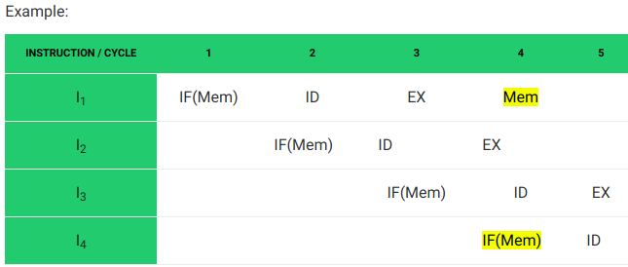
Structural Hazards
Caused by access to memory by two segments at the same time. Most conflicts can be resolved by using separate instruction & data memory.
An example is a single memory unit that is accessed both in the fetch stage where an instruction is retrieved from memory, and the memory stage where data is written &/or read from memory.

Slide 7
Solution
Pipeline Bubbling: method to preclude data, structural, and branch hazards. As instructions are fetched, control logic determines whether a hazard could/will occur. If this is true, then the control logic inserts no operations (NOPs) into the pipeline. Thus, before the next instruction (which would cause the hazard) executes, the prior one will have had sufficient time to finish and prevent the hazard.
Flushing: Flushing the pipeline occurs when a branch instruction jumps to a new memory location, invalidating all prior stages in the pipeline. These prior stages are cleared, allowing the pipeline to continue at the new instruction indicated by the branch.
Duplicating: Add more hardware to design so that each instruction can access independent resources at the same time. This removes structural conflicts.

Slide 8
Data Hazards
Data hazards occur when instructions that exhibit data dependence modify data in different stages of a pipeline. Ignoring potential data hazards can result in race conditions (also termed race hazards).
Its types are:
RAW : A read after write data hazard refers to a situation where an instruction refers to a result that has not yet been calculated or retrieved. This can occur because even though an instruction is executed after a prior instruction, the prior instruction has been processed only partly through the pipeline.
WAR : A write after read data hazard represents a problem with concurrent execution.
WAW : A write after write data hazard may occur in a concurrent execution environment.

Slide 9
Solution
Instruction Reordering: Re-ordering technique is very simple and efficient way to remove Some Data hazards that occur during execution instruction in Pipeline.
Pipeline Stalls: The simplest way to fix the hazard is Stalls are inserted to skip one stall cycle & instruction is waiting until other same instruction or depended instruction complete or data hazard is chance is leave. to stall the pipeline.
Data Forwarding: also known as bypassing is an efficient way to solve data hazards in pipelined instruction execution. In this technique, normal processor is updated with special hardware. Here the result of one stage is forward before complete execution of particular instruction. Where the result is require it is directly pass to that pipeline stage. In the forwarding there is no restriction from which stage data is transfer to next every next stage.

Slide 10
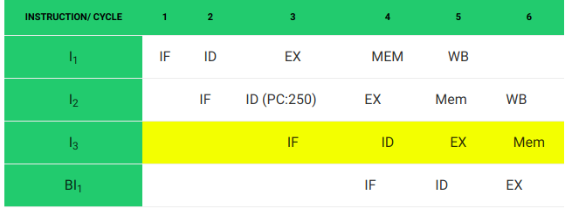
Control Hazards
Branching hazards (also termed control hazards) occur with branches. On many instruction pipeline micro architectures, the processor will not know the outcome of the branch when it needs to insert a new instruction into the pipeline (normally the fetch stage).

Slide 11
Solution
Branch Prediction: Instructions are speculatively fetched and executed down the predicted path, but results are not written back to the register file until the branch is executed and the prediction is verified. When a branch is predicted, the processor enters a speculative mode in which results are written to another register file that mirrors the architected register file.
Pipeline Stall: Freeze the pipeline until the branch outcome and target are known, then proceed with fetch. Thus, every branch instruction incurs a penalty equal to the number of stall cycles.
Delayed Branching: Compiler first detects the Hazards then analyzes the instruction where dependencies or data hazard occur, NOP or bubbles are inserted by the compiler between these instructions that has dependencies.

Slide 12
Conclusion
Structural Hazard
Data Hazard
Control Hazard
occur when different instructions collide while trying to access the same piece of hardware in the same segment of a pipeline. This type of hazard can be alleviated by having redundant hardware for the segments wherein the collision occurs. Occasionally, it is possible to insert stalls or reorder instructions to omit this type of hazard.
when an instruction depends on the result of a previous instruction still in the pipeline, which result has not yet been computed. The remedy inserts stalls in the execution sequence, which reduces the pipeline's efficiency. One can forward the ALU result to the writeback or data fetch stages. It is possible to restructure the code to eliminate some data dependencies.
can result from branch instructions. Here, the branch target address might not be ready in time for the branch to be taken, which results in stalls (dead segments) in the pipeline that have to be inserted as local wait events, until processing can resume after the branch target is executed. Control hazards can be mitigated through accurate branch prediction (which is difficult), and by delayed branch strategies.

Slide 13
Thank You!

